Slide 1
Audit Tab Overhaul
TFS Story: 1237 – Inventory: Audit Tab Overhaul
Last Update: pfry 5/5 @ 1530

Slide 2
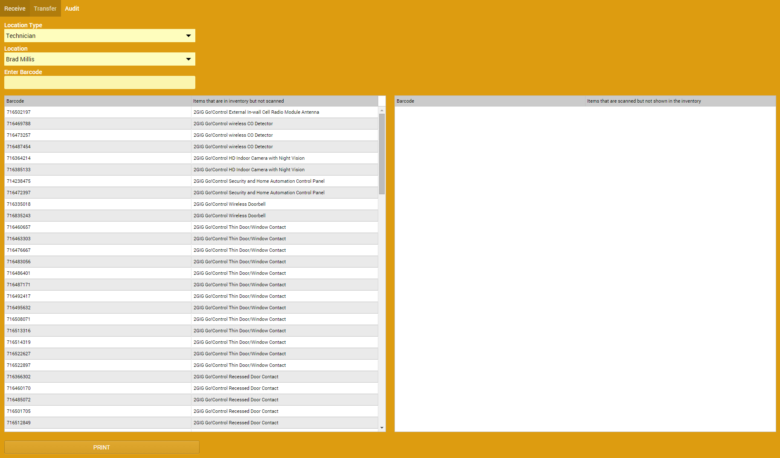
Current Layout
Standing issues with the Audit Screen:
Scanning barcodes does not update that barcodes tracking history
Scanning a barcode a 2nd (or more) times puts it in the table on the right
Left Table is a list of equipment that has been assigned to the person (and has not been scanned)
Right Table is a list of equipment that has been scanned and is not currently assigned to that technician

Slide 3
Layout Adjustments
To the right of the drop downs include a table that shows an audit history with the following information:
Audit ID
Auditor
Audit Date
IsClosed (bit)
Add a New Audit and a Load Audit button
New will just load what it does now, Load Audit will display the table results when they submitted it (see slide 6-7).

Slide 4
Improvements
As we scan barcodes we should remove that item from the table on the left and update the barcode tracking that the part was part of the audit (Tracking Type: AUD).
Upon finishing the initial scan any equipment that was not scanned will remain in the left table.
And any equipment that was scanned but is not part of my stock will be in the right table.

Slide 5
Submitting Audit
Add a Submit button that will log every piece in the left table as not accounted for in the audit and update the tracking to show as: “AUD-MISS”
Any equipment in the left table will be assigned to the technician and barcode tracking will be updated accordingly.
Tracking of Audits will need to be created.

Slide 6
Allow updates after an audit has been completed
Once an audit has been submitted a technician will have a limited amount of time (24hrs?) to add equipment to that audit, updating it’s ModifiedOn.
So that if I find a piece of equipment in my car or tool kit I don’t have to do another audit just to mark that piece accounted for.
After the time window expires the audit will be closed and a new audit will need to be performed.

Slide 7
Loading past audits
Loading an audit will need to have an additional column in the left window to show that that part was accounted for in the audit.
And sorted by whether or not it was audited.

Slide 8
Reconcile Equipment
From my understanding Platinum’s system would look at all the accounts I’d installed and look for equipment that was added by part # and did not have a barcode and assign those barcodes to those parts cleaning out my “this is yours but you didn’t scan it” list.
We would have to match based off of the ModelNumber in the AE_Items table.
This button should only be clickable AFTER the Submit Audit button has been pressed.
Tracking for that part would show as AUD-MISS and then CUST as our indicator that it was reconciled. Or we could create a tracking type of reconciled.

Slide 9
Final Layout
New Audit
Audit History Table
Laod Audit
Updated layout design.
Audits should be possible to be done on both Technicians and Warehouses
Submit Audit
Reconcile

